Slide 1
BALANCING PASSION & PERSPECTIVE IN THE LEGAL INDUSTRY: A MINDFULESS APPROACH Professor David M. Zlotnick Roger Williams University School of Law https://www.youtube.com/watch?v=aGZGbPm0NHI

Slide 2
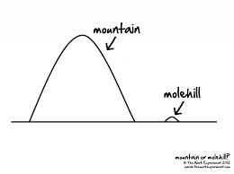
THERE ARE NO QUICK FIXES FOR LAWYER STRESS

Slide 3
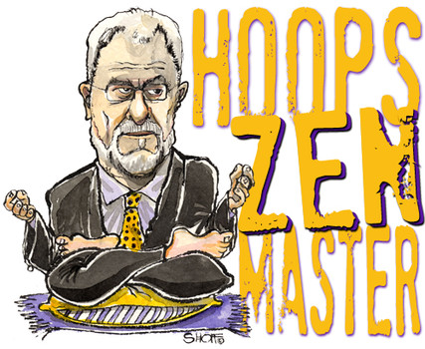
MINDFULNESS IS HAVING IT’S MOMENT
How Meditation Changes the Brain and Body FEBRUARY 18, 2016
Why Companies Are Promoting Mindfulness at the Office
By ANGELA CHEN
Mar 16, 2015

Slide 4
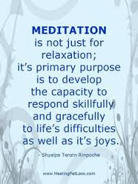
MINDFULNESS & SELF-CARE

Slide 5
MINDFULNESS FOR LAWYERS WORKS
Daily Sitting Practice
Deposition Binder “Cushion”
Yoga
Biking to Work
Mindful Listening
DC Mindful Lawyers group

Slide 6
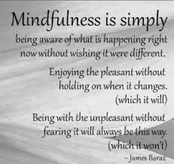
Mindfulness: A Definition
“Being aware moment to moment of whatever is happening --without judgment .”

Slide 7
THE MINDFUL MENTAL STATE

Slide 8
DISTINGUISHING MINDFULNESS MEDITATION
Other Meditative Practices
Concentration meditation
Mantras/TM
Relaxation meditation
Visualization/Guided
Devotional/Heart-Centered Meditation
Chanting
Yoga
Tai Chi
Running/Biking/Swimming
Needlepoint
???

Slide 9
CONCENTRATION PRACTICE: FOLLOWING THE BREATHE

Slide 10
COMPASSION PRACTICE: BEGINNERS’ MIND

Slide 11
PASSION v. PERSPECTIVE

Slide 12
Passion v. Perspective: Speaking & Listening Exercise

Slide 13
WHEN PASSION & PERSPECTIVE GO OFF THE RAILS

Slide 14
MINDFULNESS FOR ANGER, FEAR & ANXIETY

Slide 15
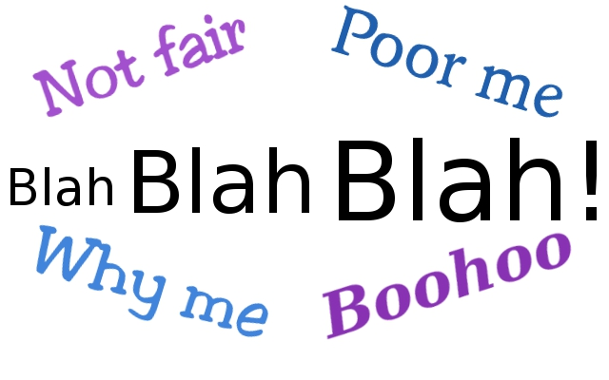
“MINDFUL” COMPLAINING

Slide 16
MINDFULNESS THEORY & THE PASSION v. PERSPECTIVE CONUNDRUM

Slide 17
MINDFULNESS THEORY & DOUBT: “PERSPECTIVE” HOLDING THE SPACE FOR “PASSION”

Slide 18
CONVINCING LAWYERS TO PRACTICE: SMALL STEPS
Proceedings of the National Academy of Sciences of the United States of America www.pnas.org
Short-term meditation training improves attention and self-regulation. . . . This article shows that a group randomly assigned to 5 days of meditation practice with the integrative body–mind training method shows significantly better attention and control of stress than a similarly chosen control group given relaxation training. . . .

Slide 19
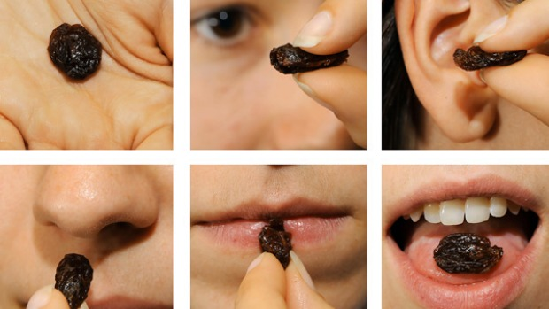
SMALL STEPS EXERCISE: MINDFUL EATING

Slide 20
CONVINCING LAWYERS TO PRACTICE: THE MINDFULESS WARRIOR

Slide 21
CLOSING MEDITATION Let me breathe in the future without fear, Let me breathe out the past without regret, And so arrive in the present moment – without judgment.

Slide 22
https://www.youtube.com/watch?v=aGZGbPm0NHI

Slide 23
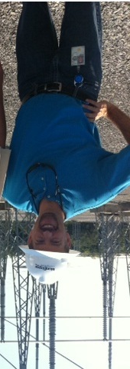
CONTACT INFORMATION
Professor David M. Zlotnick
E-mail: dzlotnick@law.rwu.edu
Tel: (202) 502-8094
website: http://faculty.rwu.edu/dzlotnick/

