Slide 1

When asked to name the most common skills gaps they encounter in recruiting, responding HR professionals noted CRITICAL THINKING and PROBLEM-SOLVING, professionalism and work ethic, written communications and leadership.
SHRM poll surveyed more than 3,400 HR professionals randomly chosen from the society’s membership

Slide 2
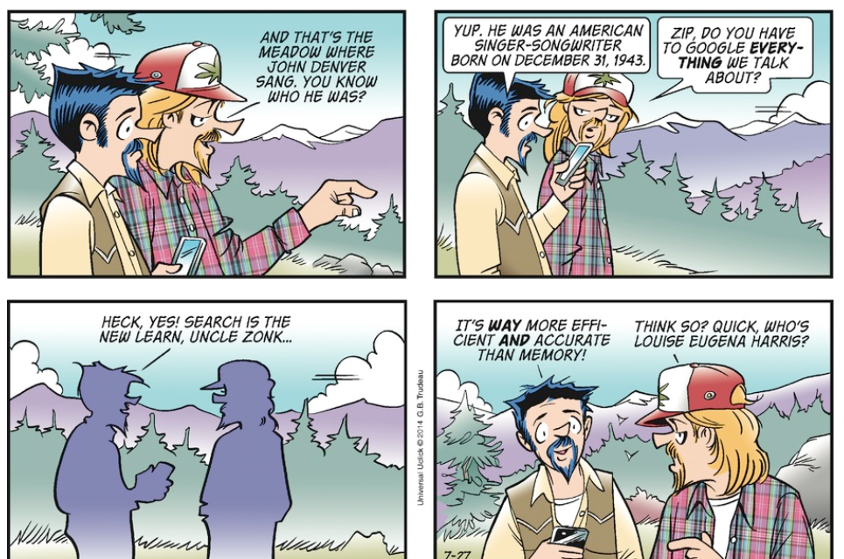
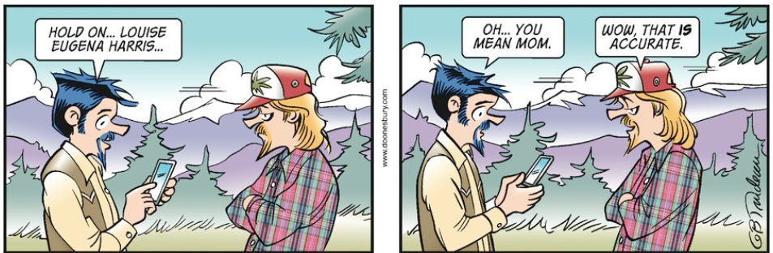

Slide 3
Understanding What Drives the Adult Learner to Enhance Learning Outcomes

Slide 4


Nanette Miner, Ed.D.
Custom Design of Training
Training Triage
Teach SMEs how to design training

Slide 5
What’s the Difference? IS THERE a Difference?
Education
Training
Learning

Slide 6
What’s the Difference? IS THERE a Difference?
Education
Training
Learning
Regarding | Children | Adults
Concept of the learner | Dependent | Self directed
Experience | To be built | Resource for self and others
Readiness to learn | Uniform by age level | Develops from life tasks /needs
Orientation to learning | Subject oriented | Task or problem-centered
Motivation | External | Internal
I know
something
I can do
something
I know what and how to do
something and WHY

Slide 7

Everything we know about Adult Learning…
White
  American
    Mostly male
      College students
        Of the 1970’s
Dude,
I am so bored

Slide 8


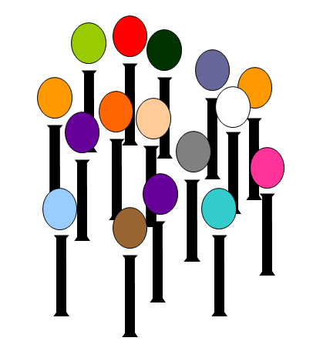


The adult’s approach to learning / training
Self direction
Experiential techniques
Relevancy to real-life
Immediate applicability
  Adults are competency based learners
Malcolm Knowles
1913 - 1997

Slide 9
The adult’s approach to learning / training
Self direction
Experiential techniques
Relevancy to real-life
Immediate applicability
  Adults are competency based learners
Individual differences among adult learners increase with age and experience. Therefore adult learning programs must make provisions for differences in style, time, place and pace of learning.
Malcolm Knowles
1913 - 1997
Notes:
Immediately applicable: As adults, we don’t learn something because it might be useful in the future… (NOBODY is learning Turbo Tax right now)
What can we do to make the transfer of training back to the job immediate? (assignments, enlist manager’s help, ‘learning contract’)
Example: BP – action learning assignment
Competency Focused– when I finish this lesson I better be able to DO something (I am always amazed at how many people sign up for this series because it is all theory)
BUILD Malcolm's name – and say These are the basic adult learning tenets of Malcolm Knowles, who is known as the Father of Adult Learning Theory; and remember, these 4 keys are based on research of people who took on learning as adults - - so while NOT based on workplace learning / learners, I think you can see that these make sense for us as well.
Transition: So today, already, you’ve probably had a few ah-ha’s about the work that you do, and you’ve built up a great repertoire of ways to appeal to your adult learners through the chat exercise we just completed. Remember earlier today I said that educating, training and learning all have their place so long as you understand what you are trying to achieve… if you want people to learn, but instead you are educating them – you will not be successful… so let’s look at the typical four learning outcomes we want to achieve…

Slide 10

Workplace Learning Outcomes
Changed Behavior
Enhanced /
Critical Thinking Skills
Psychomotor Skills
New Knowledge

Slide 11
The adult learns by…
Experience
Live It. Learn It.

Slide 12


The adult learns by…
Experience
Live It. Learn It.
Observation and reflection
What happened? Why? Can it happen again? Do I want it to?
Is this a good thing or a bad thing? What have I learned from this?

Slide 13

The adult learns by…
Experience
Live It. Learn It.
Observation and reflection
What happened? Why? Can it happen again? Do I want it to?
Is this a good thing or a bad thing? What have I learned from this?
Thinking
Questioning: Why? Why now? What if? What if not? Yeah, but…

Slide 14
Question + Answer Techniques
Questions can be Open or Closed
Turn closed questions in to open questions
Simple but important distinction:
Do you have any questions? vs. What questions do you have?
T E D
Tell, Explain, Describe
TED

Slide 15

Question + Answer Techniques
WHO?
Perspective
Change the “who” in the question
What if you were the customer?
Why would the town want to enact such a law?
If you were the inspector, what would you be looking for?
Change the “side of the argument”
Loss
Remove something from the equation so that it causes them to think about the situation in a different way
What if we didn’t have to charge penalties / fees?
What would happen if we didn’t enforce the SLA?
What if we didn’t have a quality department?

Slide 16
Question + Answer Techniques
Comparative
Compare two items
Before to after
Old job to new job
Old rules / regs to new rules / regs

Slide 17
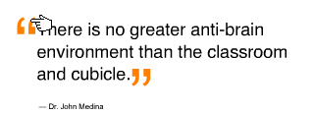
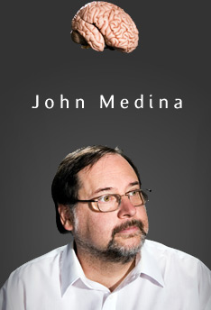
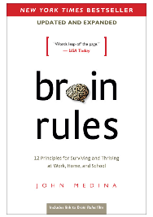
Brain Rules
If you want to create an education environment that is directly opposed to what the brain is good at doing, you would probably design something like a classroom.
Notes:
Along the same lines as what Knowles said about classroom configuration… A more up-to-date researcher says….
READ boxes
BUILD SLIDE
This fellow is not an adult learning theorist, but a brain researcher - he has spent decades trying to figure out what part of the brain does what… and how…
A lot of today’s Adult Learning Theory is based on how our brains receive, store and retrieve information… so it’s not what do we respond well to? (like what we previously discussed); but how do we actually process information?
TRANSITION: Let’s go back to our Adult Learning Theorists though; we’ll come back to Medina in our next session
We’ve already talked about Malcolm Knowles….

Slide 18
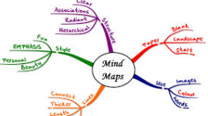
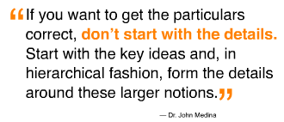
Using Brain Rules to Ensure Learning
✰ Structure + Hierarchy
1
The first step is to…
2
The 2nd step…
3
This is the 3rd thing you do…

Slide 19
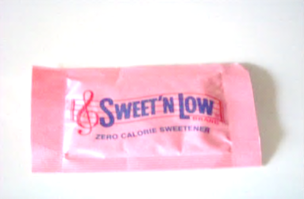



Using Brain Rules to Ensure Learning
✰ Visuals
People respond better to visuals (pictures are a more efficient delivery mechanism, than text)
Visuals can be real
Descriptions can evoke images
Make images up
Neuron Island
Cells Island

Slide 20
Efficiently Adding Adult Learning Theory to your Current Training Programs
1
Keep in mind: Are you providing information or enabling learning?
Create the ability for observation and reflection.
Use a variety of question-types.
Learning journals / mind maps.
2
3
Create structure and hierarchy as part of the design – don’t require learners to figure out how the ‘information fits’ on their own.
4
Use visuals.
They are stimulating AND work as a mnemonic device + anchor.

Slide 21




Connect with us
www.trainingdr.com
and www.trainingdr.com/blog
The Training Doctor LLC
@trainingdoctor
843.743.9899
Notes:
Lucky you – this is the first session on the first day and I am here all week..
So if you would like some FREE consulting – feel free to set up a time to meet – I am usually hanging out in the speaker ready room (room ___________) so we can meet there to be sure we find each other and then go off to a quiet place.
My cell phone is here on the screen – feel free to call or text

